Slide 1
Transaction Ping-Pong game

Slide 2

The idea
2 Players (wallets)
Player 1
Player 2

Slide 3
The idea
2 Players (wallets)
One player starts the game
Player 1
Player 2
NFT

Slide 4

The idea
2 Players (wallets)
One player starts the game
Other player will get the ball NFT and the deadline when to bounce it back.
Player 1
24 hours
Player 2
NFT

Slide 5
The idea
2 Players (wallets)
One player starts the game
Other player will get the ball NFT and the deadline when to bounce it back.
If player hits the ball before deadline, then the other player gets the ball and a new deadline.
Player 1
24 hours
Player 2
NFT

Slide 6

The idea
2 Players (wallets)
One player starts the game
Other player will get the ball NFT and the deadline when to bounce it back.
If player hits the ball before deadline, then the other player gets the ball and a new deadline.
When some player misses the deadline, he/she loses and the other wins the Winner NFT.
Player 1
Time’s up!
Player 2
Winner!
NFT
NFT

Slide 7
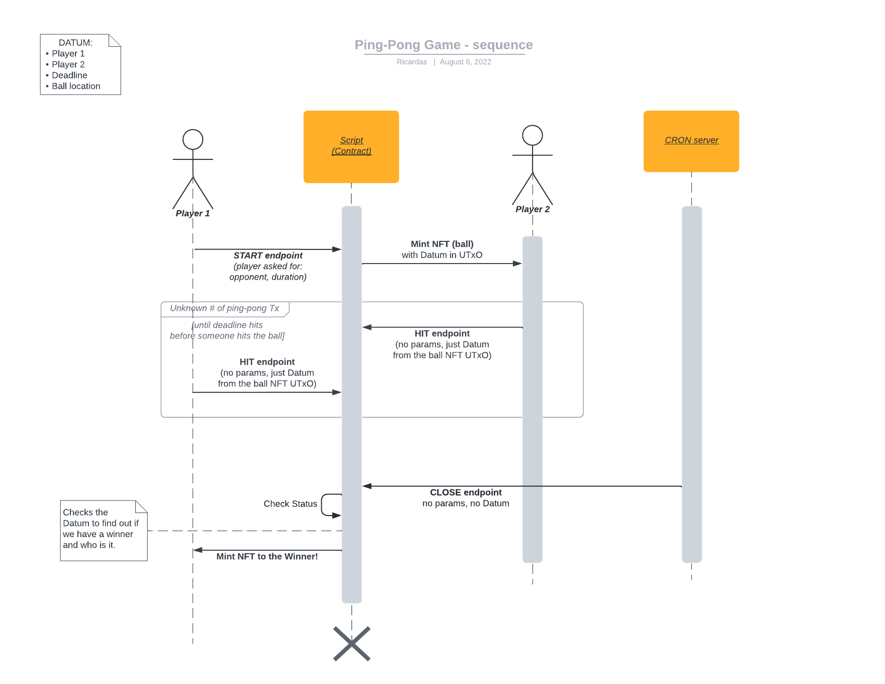
Sequence diagram

Slide 8
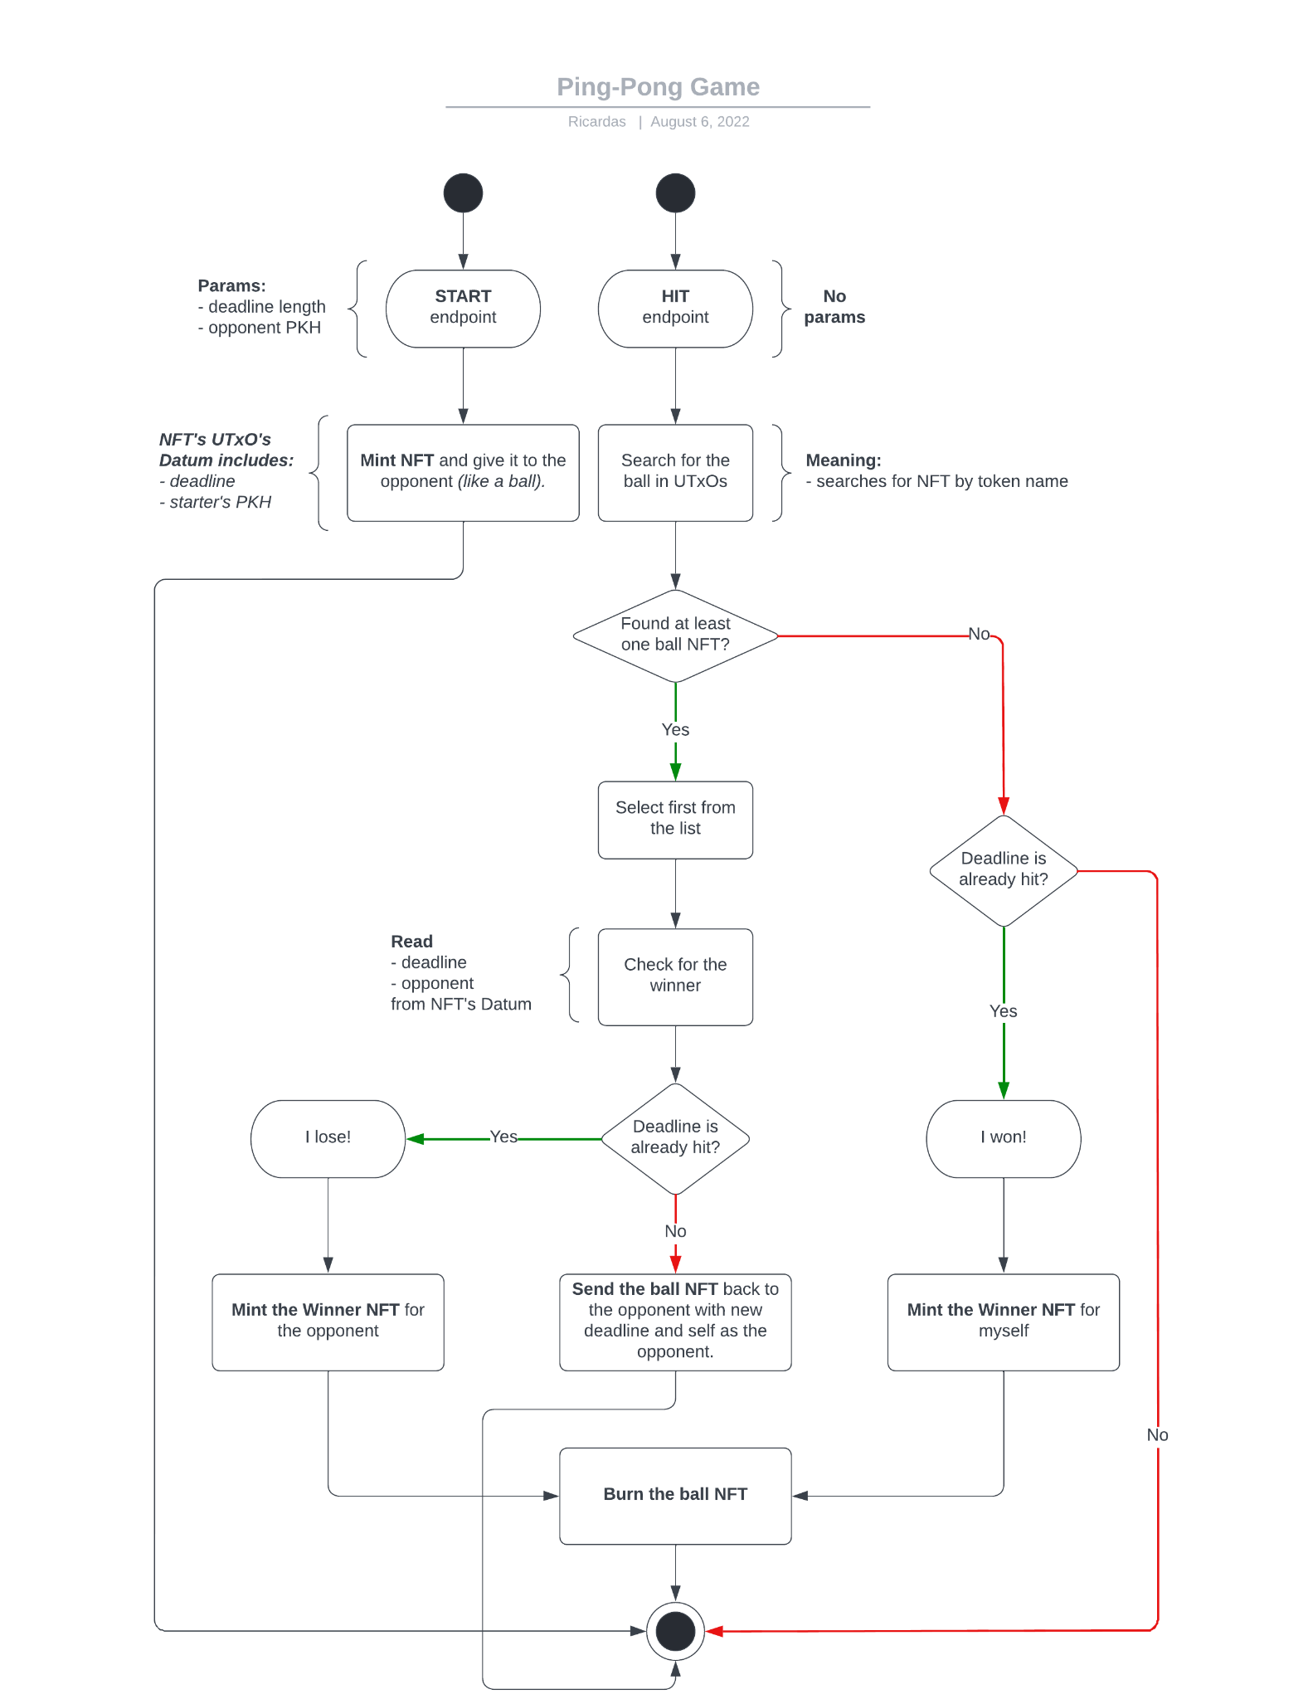
Activity diagram

